Slide 1

Carrier Services DEVOPS CoE

Slide 2
Agenda
Business Drivers
SAFe
DevOps CoE formation
Review DevOps current state
Review / Redefine Allegis CoE blueprint

Slide 3
DEVOPS - business DRIVERS

Slide 4




DevOps Business Drivers
 | Cost Rising TCO of hardware and software Eliminate waste up & down Apps & Infra lifecycles, Infrastructure Stability
 | Agility Getting new products to the market sooner - support Sales pipeline Lowering cost by having more stable platform Built for the customer
 | Elasticity Predictive analysis and Scalability on-demand
 | Security/Compliance/Regulatory requirements Manage against evolving vulnerabilities/threats Less time on remediating security issues

Slide 5



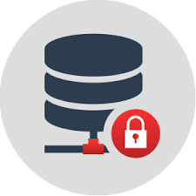
DevOps Business Drivers (Cont.)
 | Quality Built into all phases of development Automated tests (Unit, Integration, and Regression)
 | Visibility Traceability
 | Faster value delivery Faster feedback Cycles Accelerate Velocity Increased collaboration
 | Data Governance Standard set of well-defined processes for Data Governance during DevOps Transformation

Slide 6
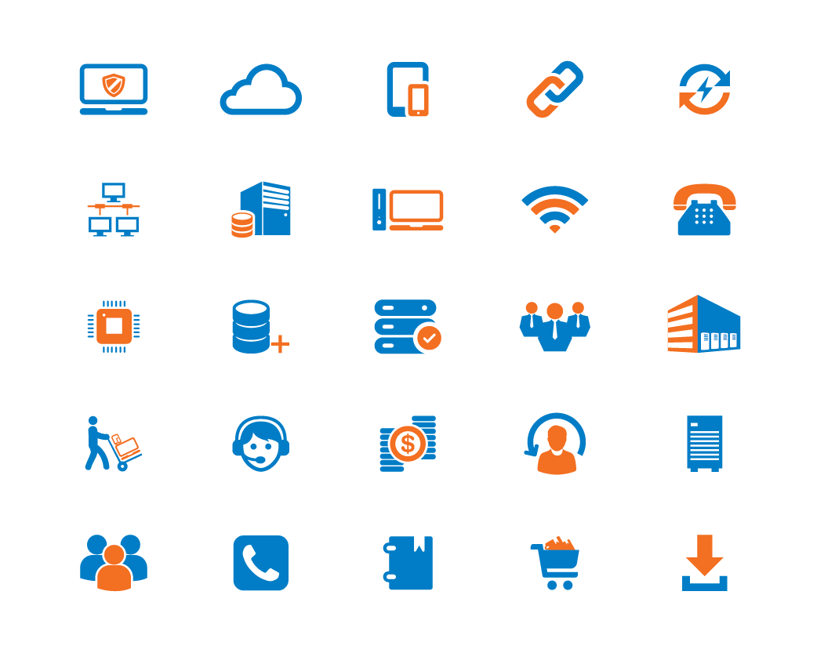
TEKsystems Transformation & Innovation Framework
Continuous Integration
Continuous Testing
CONTINUOUS
Scaling | Infrastructure
Compliance | Security | Analytics Learning Improvement
Continuous Experimentation
Continuous Delivery
Business | Leadership
Governance | Portfolio
Continuous Development/ Engineering
Continuous Marketing
ALLEGIS
Continuous Monitoring
Continuous Deployment/Release
Organizational Design & Change Management
Agile & Lean Principles and Practices
Service Management
Notes:
We developed the TEKsystems Transformation & Innovation Framework to ensure holistic coverage for your transformation journey. We focus on understanding and transforming your organization using an Enterprise, Shared Services, and Value Stream lens. We drill deep within each of these three areas with the goal of modernizing your people, processes, and technologies to drive your desired business outcomes. During our discovery phase, our Framework enables us to drive the right conversations in the right context. In later phases, we will continue to follow our framework and accompanying program to partner and drive your transformation journey.

Slide 7
Scaled agile framework
Assessment Summary

Slide 8
Agile, SAFe and DevOps
Agile software development method emphasis on iterative, incremental, and evolutionary development. Agile refers to an iterative approach which focuses on collaboration, customer feedback, and small, rapid releases.
Scaled Agile Framework (SAFe®) helps businesses address the significant challenges of developing and delivering enterprise-class software and systems in the shortest sustainable lead time. It is a freely revealed, online knowledge base of proven success patterns, for people building the world’s most important software and systems. © Scaled Agile, Inc.
DevOps represents a change in IT culture, focusing on rapid IT service delivery through the adoption of agile, lean practices in the context of a system-oriented approach. DevOps emphasizes people (and culture) and seeks to improve collaboration between operations and development teams. © Gartner

Slide 9
Portfolio SAFe
https://scaledagileframework.com/#

Slide 10
Agile Portfolio Management
Current State
Desired Outcomes
Required Capabilities
Carrier Services has maturity in adoption to DevOps practices.
Jenkins pipelines exist for multiple applications & infrastructure. 30+ workloads are active.
Scrum is followed by the teams.
DevOps as a cultural change is actively considered by the Management..
DevOps process & toolset are adopted but standardization is not started.
SAFe Adoption
Identify industry Standards and Tools that suit Allegis requirements
Incremental short releases with automated testing
Eliminate Silos and Improve Collaboration
Faster Feedback cycles from each group
Track DevOps Metrics at various levels
Increased Velocity for delivering a feature or a change
Offer and encourage SAFe training for Management , Developers and Operations staff.
DevOps as a cultural shift must be programmed and adopted across the teams.
Visibility into projects using Scrum & Agile Boards must be mandated for Development, Operations, and Product.
Engage partnership programs for SAFe.
Define SLAs and KPIs for products & value streams. ***

Slide 11
DevOps – Maturity Model

Slide 12
DevOps Maturity Model
Top Level: DevOps Phase III
Self Managed Product Teams | dynamic process | near instant continuous deployment of changes | no dev related outages
05
Enhanced: DevOps Phase II
Business Service Delivery across Product Teams | no manual processes across services delivery | continuous delivery | end2end managed environments | KPI managed
04
Co-ordinated: DevOps Phase I
DevOps with Coach & Governance| dev2ops connected lifecycle within a product team through process and tool enablement | limited manual processes | low release duration & significantly reduced outages | KPI reported and monitored
03
5 level of DevOps Maturity model
Emerging: System Thinking
Emergence of joint teams | starting to establish connected processes | some automation & isolated tools | medium release duration & reduced outages
02
Basic: - Should be in the past
Traditional Silo’ed Organization | separate processes | separate tools with many manual activities | typically very long release duration and high outages
01

Slide 13
DevOps - current state

Slide 14
Tools adoption Matrix
 |  |  | Artifactory | Bitbucket | Confluence | Slack |  | Jenkins | SonarQube |  |  | Logging / Splunk | Selenium | Monitoring
Brroklyn 2 |  |  | Y | Y | Y | Y |  | Y

Slide 15
Tools Ownership Matrix
 | Carrier Services |  |  | Monitoring Team
Artifactory
Bitbucket
Confluence
Slack
Jenkins
SonarQube
CodeScan
Selenium
Splunk
New Relic

Slide 16
Application – DevOps maturity
Code – security scans at developer level
Code scans at deployment level
Code scans at runtime.
Configuration management for platform & code
Test suite integration as CI for Jenkins
Perf tool integration as CI
Approval gates automation
Integration of ITSM to Jenkins jobs
Feed back loops for monitoring systems to developers and test teams
Monitoring dashboards for Apps & Infrastructure
Debt Analysis for top 5 reoccurring issues.
Security dashboard for platform & code
Capacity dashboard for platform & code

Slide 17
DevOps Current State
SAFe – Team Structure, SAFe methodologies at early stage of adoption.
Consistent Repeatable Environments - Differences in Development, QA and Production environments (Missing Configuration Management tool, CI is lacking adoption for Test / Validation.
Slower Infrastructure deployments – Physical servers deployment, patching is through ITSM requests and staged team approvals. Infrastructure as a Code (IaC) is missing.
Lack of Shared ownership / Silos - Feedback loops across teams is missing. Lead metrics / KPM’s yet to be established.
Configuration management – Configuration Management Tool is implemented for server deployments and cert deployments (Ansible). Application config management implementation must be established.
Parallel CI/CD toolsets –Jenkins. Multiple installations and maintained by multiple teams.
Code Scanners – SonarQube, Code Scan implementation is yet to be identified.
KPI / Metrics – Metrics for DevOps process & Toolsets is not adopted.***
DevOps Maturity Dashboard – Publish DevOps maturity dashboard adoption for each application.

Slide 18
DevOps Current State – Contd.
Security & Governance – End-to-end Security Controls view & Assessment Dashboards to be implemented.
Continuous Monitoring – Log Monitoring System (Splunk) implemented. Alert life cycle management System ( ALMS) yet to be considered.
Application deployments to be fully automated with full CI integration with Test. Monitoring & ITSM systems. (semi-automation to full-automation)
Current debt analysis must be developed.
Improvement life cycle for top 5 reoccurring debts must be solved through automation.
Operational dashboards covering monitoring & alerting must be driven from splunk and other App monitoring systems.
Capacity management dashboards must be developed and co-related with operational dashboards.

Slide 19
DEVOPS - Future state

Slide 20
Future state
SAFe Approach – Teams Structure / Share Responsibility Model
Metrics driven dashboards for Security, Capacity, Monitoring, Alerting & Issues to be published
Formation of Systems team (ST) for DevOps – ART, Release cycle, Tools ownership.
Publish current & Future state for tools, platform, code, visibility dashboards.
Define / review KPI metrics for onboarded tools / Applications / Infrastructure
Containerization roadmap for Carrier services applications , Container Security & Monitoring implementation details to be published.

Slide 21
Future state
SAFe Approach – Process Implementations
Enable & Measure DevOps toolsets & process adaption.
Assessment DevOps Metrics, KPI’s, Maturity dashboards
Vulnerability and GRC assessment - Continuous Security for Code & Platform
Continuous Monitoring – Assess, Identify, Measure, Increase coverage of Code and Platform.
Define Feedback Loops for Deployment, Monitoring, Alerting and Ticketing systems.
Assess and Define Risk for all workloads and platforms.
Resiliency tests for platform and code.
Capacity Dashboards must be published / reviewed.

Slide 22
Future state – DevOps current platform Ownership Matrix
DEVOPS TOOLCHAIN | SYSTEM TEAM
Artifactory
Bitbucket
Confluence
Slack
Jenkins
SonarQube / CODESCAN
Selenium / UFT
JMeter
Splunk
New Relic

Slide 23
System Team
Responsibilities :
Collaborate with Solution Architect/Engineering & Architecture Review Board (ARB)
Participate in Pre- and Post-PI Planning
Participate in Architecture Sync Participate in the Solution Demo Collaborate with Release Management Aligning technology approaches across ARTs (Agile Release Trains) © Scaled Agile, Inc.
SAFe Approach :
Decentralize Decision-Making – Voting process Enable and ownership of Continuous Delivery Pipeline and DevOps Embrace a Leadership Role for mapping roadmaps and adoption Act as Change Agents
https://scaledagileframework.com/system-and-solution-architect-engineering/

Slide 24
DevOps METRICS – tHAT MATTErS

Slide 25
KPIs for Continuous Integration
Unit test Code Coverage per repository
Number of current Vulnerabilities in Static Code Analysis per repository
Number of current Critical code violations in Static Code Analysis per repository
Number of current Major code violations in Static Code Analysis per repository
Performance test failure overall performance test in a month
% of build failures over all builds in a month
% of Unit test code coverage failure (below threshold) over total number of Unit Tests conducted in a month
Static Code Analysis failure over total number of Static code analysis conducted in a month

Slide 26
KPIs for Continuous Delivery
% of deployment failures over all deployments in a month
Number of Smoke test failure over all smoke tests done in a month by repository.
Number of Faulty release instructions over all deployments in a month.
Number of Regression test failures over all smoke tests done in a month by repository.
Number of deployment per month to Production
Number of rollbacks over total deployment to Production in a month

Slide 27
KPIs for Process Improvements
% of manual deployment over all deployment in a month (CD maturity measurement)
% of manual deployment over all deployment in a month (CD maturity measurement)
# of available automated environmental setup scripts over total # of environmental components (CD maturity measurement)
# of available automated environmental setup scripts over total # of environmental components (CD maturity measurement)
# of long living branches per repository (CI)
# of branches short living longer than 3 months (one PI) per repository (CI)
# of deployment of short living branch in QA or UAT or PROD environment in a month (CI)
# of Hot Fix deployment in a month (DevOps Level 3 maturity measurement)
Average days between Hot Fix branch deployment date and down merge date to long live branches by each long living branch per repository (CI maturity measurement)

Slide 28
Quality KPIs
BFR (Build Failure Rate) - % of failed builds
DFR (Deployment Failure Rate) - % of failed deployments
IRFR (Infrastructure-Related Failure Rate) - % of build/deployment failures related to infrastructure issues
RWR (Rework Rate) - % of tickets being reopened
ADR (Automated Detection Rate) - % of defects being detected by automated testing cycles
UWR (Unplanned Work Rate) - % of unplanned issues

Slide 29
Test Automation KPIs
Cycle time in QA - Weekly Average time between a feature deployed to QA and QA Complete is flagged or reverted back to Old Code (Exit Criteria) Cycle time in UAT - Weekly Average time between a feature (first-time entry to UAT environment) been deployed and UAT Complete is flagged or reverted back to Old Code (Exit Criteria) Cycle time in STG - Weekly Average time between a feature (first-time entry to QA environment) been deployed and Performance Test Complete is flagged or reverted back to Old Code (Exit Criteria) Cycle time between QA to UAT - Monthly Average time between a feature is QA Complete to UAT deployed. Cycle time between UAT to PROD - Monthly Average time between a feature is UAT Complete to PROD deployed including Release Management and CAB approval time. # of days between last merge date to Development Branch and date on which code get deployed to QA environment.

Slide 30
Recommendations and ROAD map

Slide 31

Thank You

